Slide 1

Automation of Weather-Based Sales and Staffing Decisions
Kunal Gaurav
AI Automation | Project 5

Slide 2
Problem
Weather in Miami, FL can be unpredictable and can change quickly.
The manager of a coffee and ice cream Kiosk situated at the coast has to account for the weather for the Kiosk’s daily operations.
Her job is to manually check the weather, then decide the product mix and staffing levels based on the weather.
This manual human operation takes a lot of time, is prone to errors and can delay daily operations

Slide 3
Solution
The solution to the issue is to implement an AI Automated workflow that :
Fetches the daily Miami forecast at 7 am. in the morning using a weather app API from Openweatherapp.org
This API returns the weather information in the form of JSON data containing details like Temperature and the General weather conditions
Use Google Gemini AI to read the JSON data and generate content
Google Gemini AI decides the Product mix depending on the weather
It suggests Staffing levels for that day
It generates 2 marketing slogans for the Kiosk for that day

Slide 4
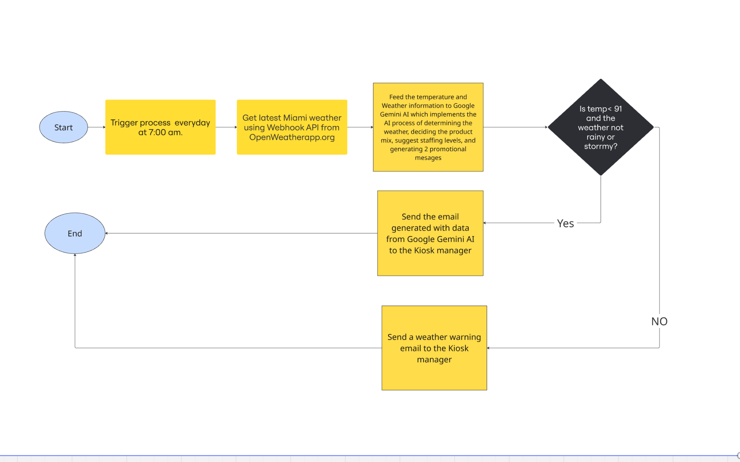
Workflow diagram

Slide 5
Workflow in action
Link to the flowchart: https://miro.com/app/board/uXjVHNMvshI=/?share_link_id=336461797309
The Zapier flow starts with a schedule trigger for 7 am in the morning every day
The Webhook module gets the weather information using the API from OpenWeatherapp.org . The Openweather API call is this:
https://api.openweathermap.org/data/2.5/weather?q=Miami,FL,US&units=imperial&appid=MY_API_KEY

Slide 6
Workflow in action(contd.)
The JSON content returned from the webhook is analyzed by the Google Gemini AI block.
Here is the prompt used to enable the module to generate information for the kiosk manager:
You are helping a retail kiosk manager plan daily operations based on the weather. Here are the details of the business:
Kiosk: Bayside Brews & Scoops
Location: Miami, FL
Weather: Main Temp °F, Description

Slide 7
Workflow in action(contd.)
Baseline products: hot drinks, cold drinks, gelato, and pastries.
Look at the weather conditions from the below values of the weather and based on that generate the below things:
1. Decide the product mix recommendation(hot drinks, cold drinks, gelato, pastries)
2. A Staffing suggestion (add staff for good weather, reduce staff for bad weather, or no change)
3. Generate 2 short promotional message under 120 characters each.

Slide 8
Workflow in action(contd.)
The data output from the AI block is converted from Markup format into HTML by using a “Formatter by Zapier” block
The Workflow is now divided into 2 paths.
The first path checks if the Temperature is less than 91° F and that there is no “storm” or “rain” in the weather description
If the above condition is met, an email is sent out to the Kiosk manager with all the analysis and suggestions generated by the AI block
The second path checks if the Temperature is greater than 91° F or if the weather description contains “storm” or “rain”
If the above description is met then a Weather advisory warning email is sent to the Kiosk manager

Slide 9
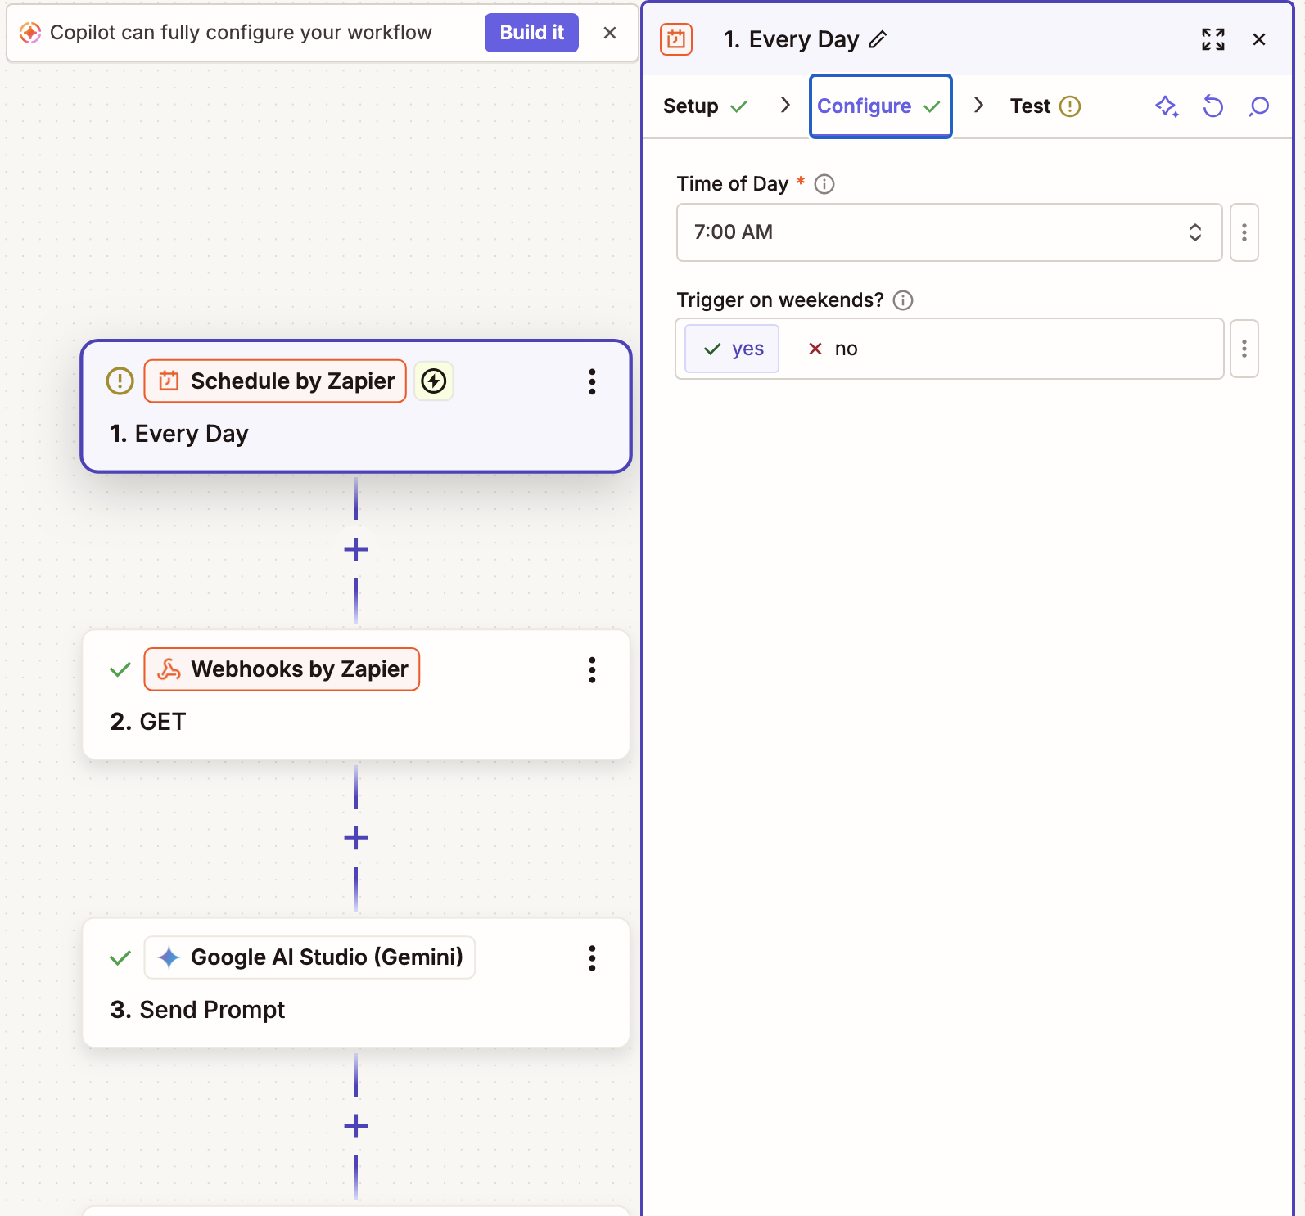
Snapshot of the Schedule Trigger Module

Slide 10
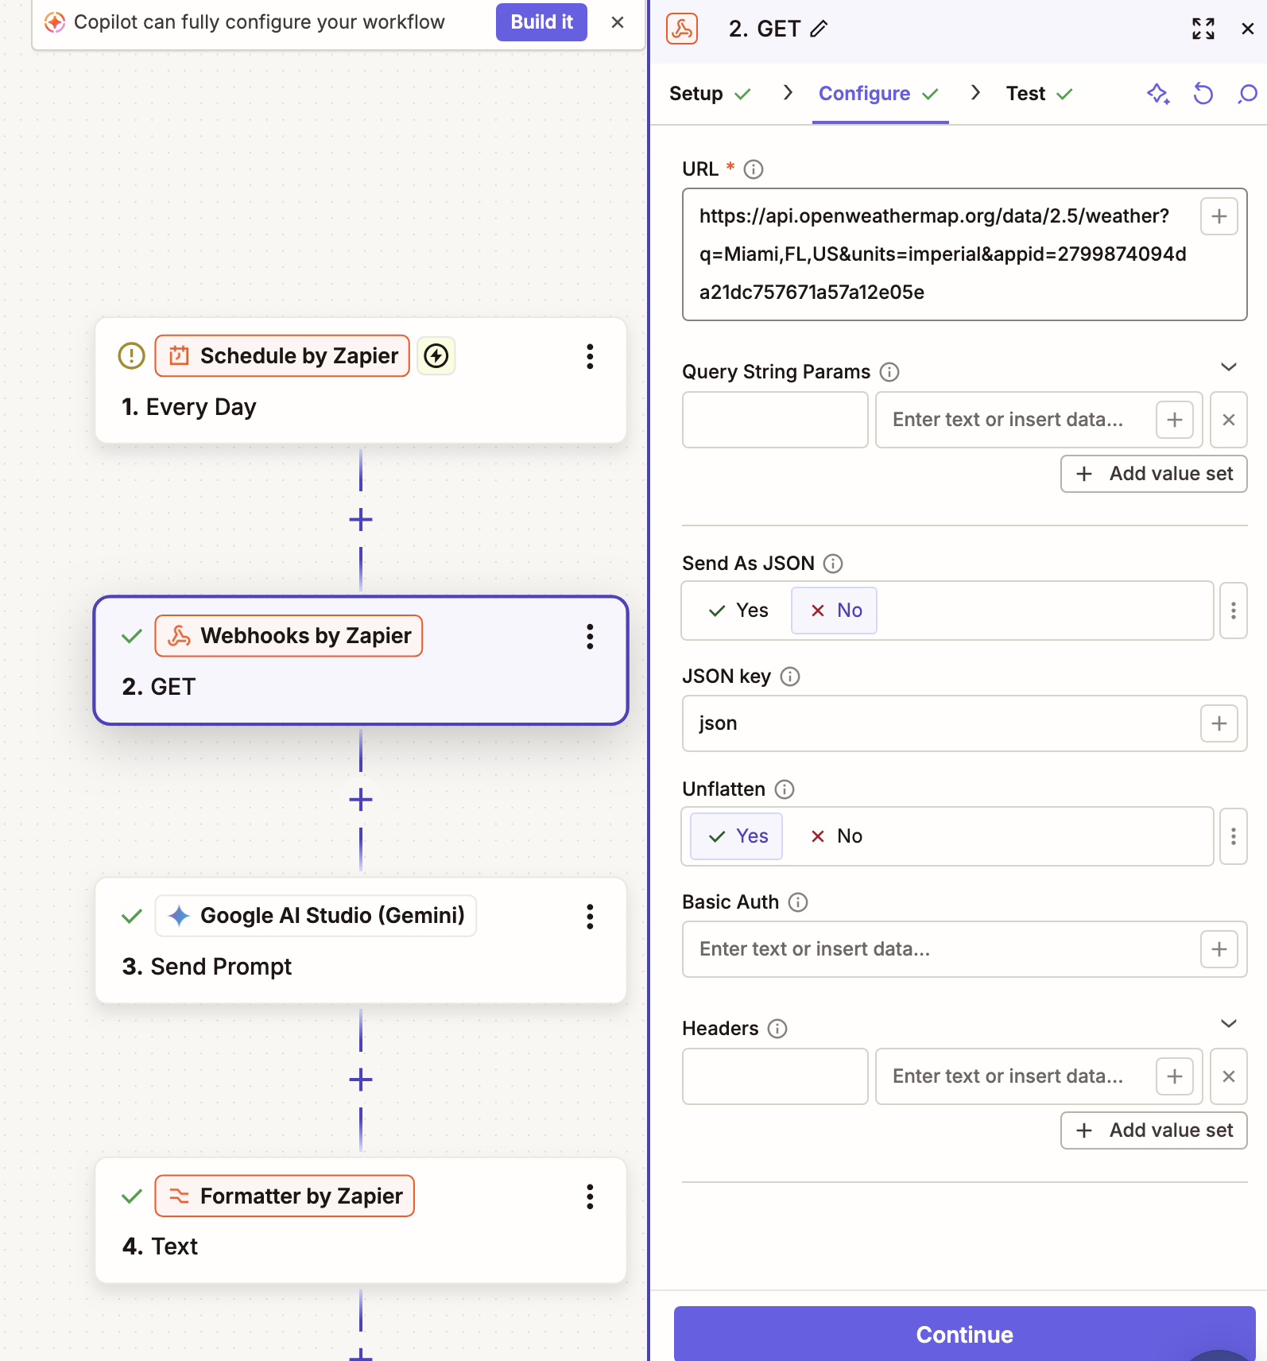
Snapshot of the Webhook by Zapier Module

Slide 11
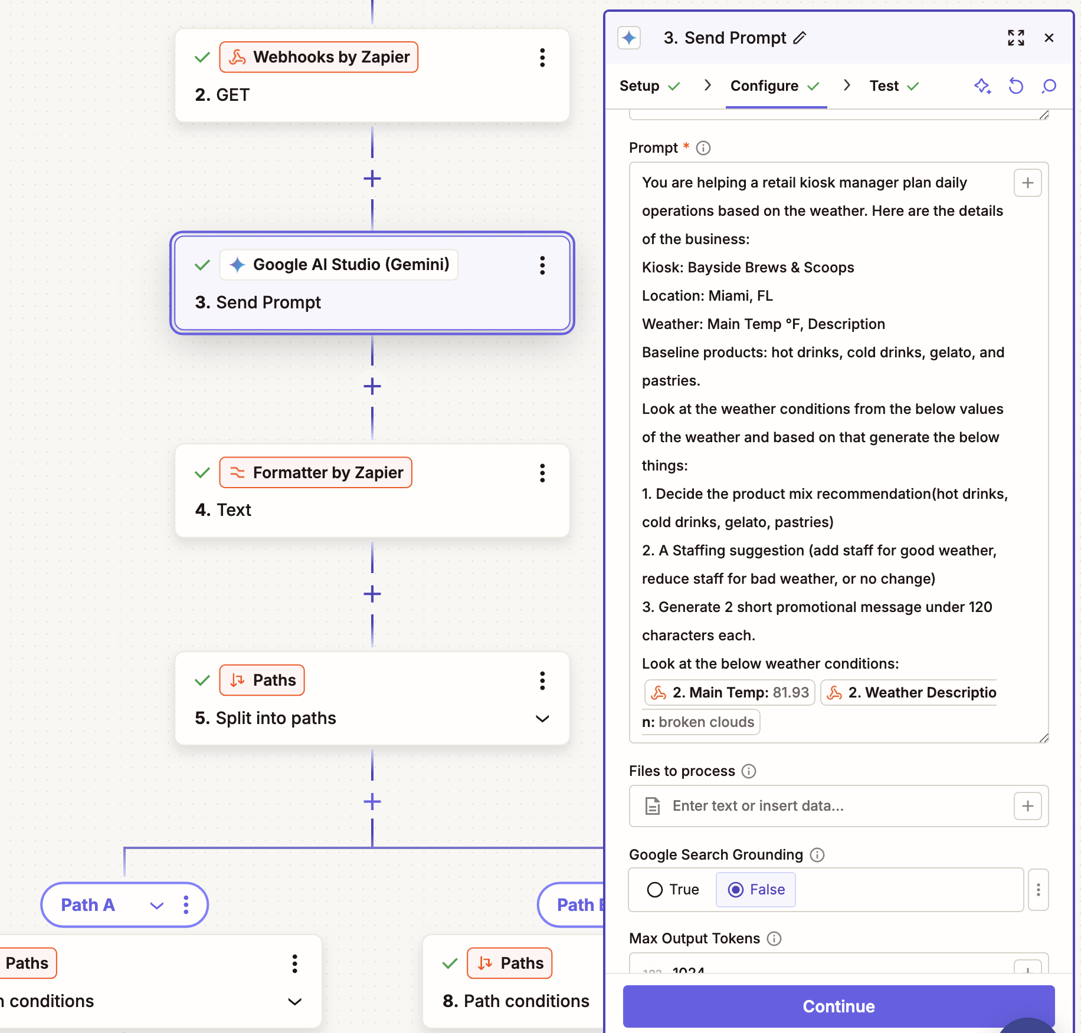
Snapshot of the Google Gemini AI module

Slide 12
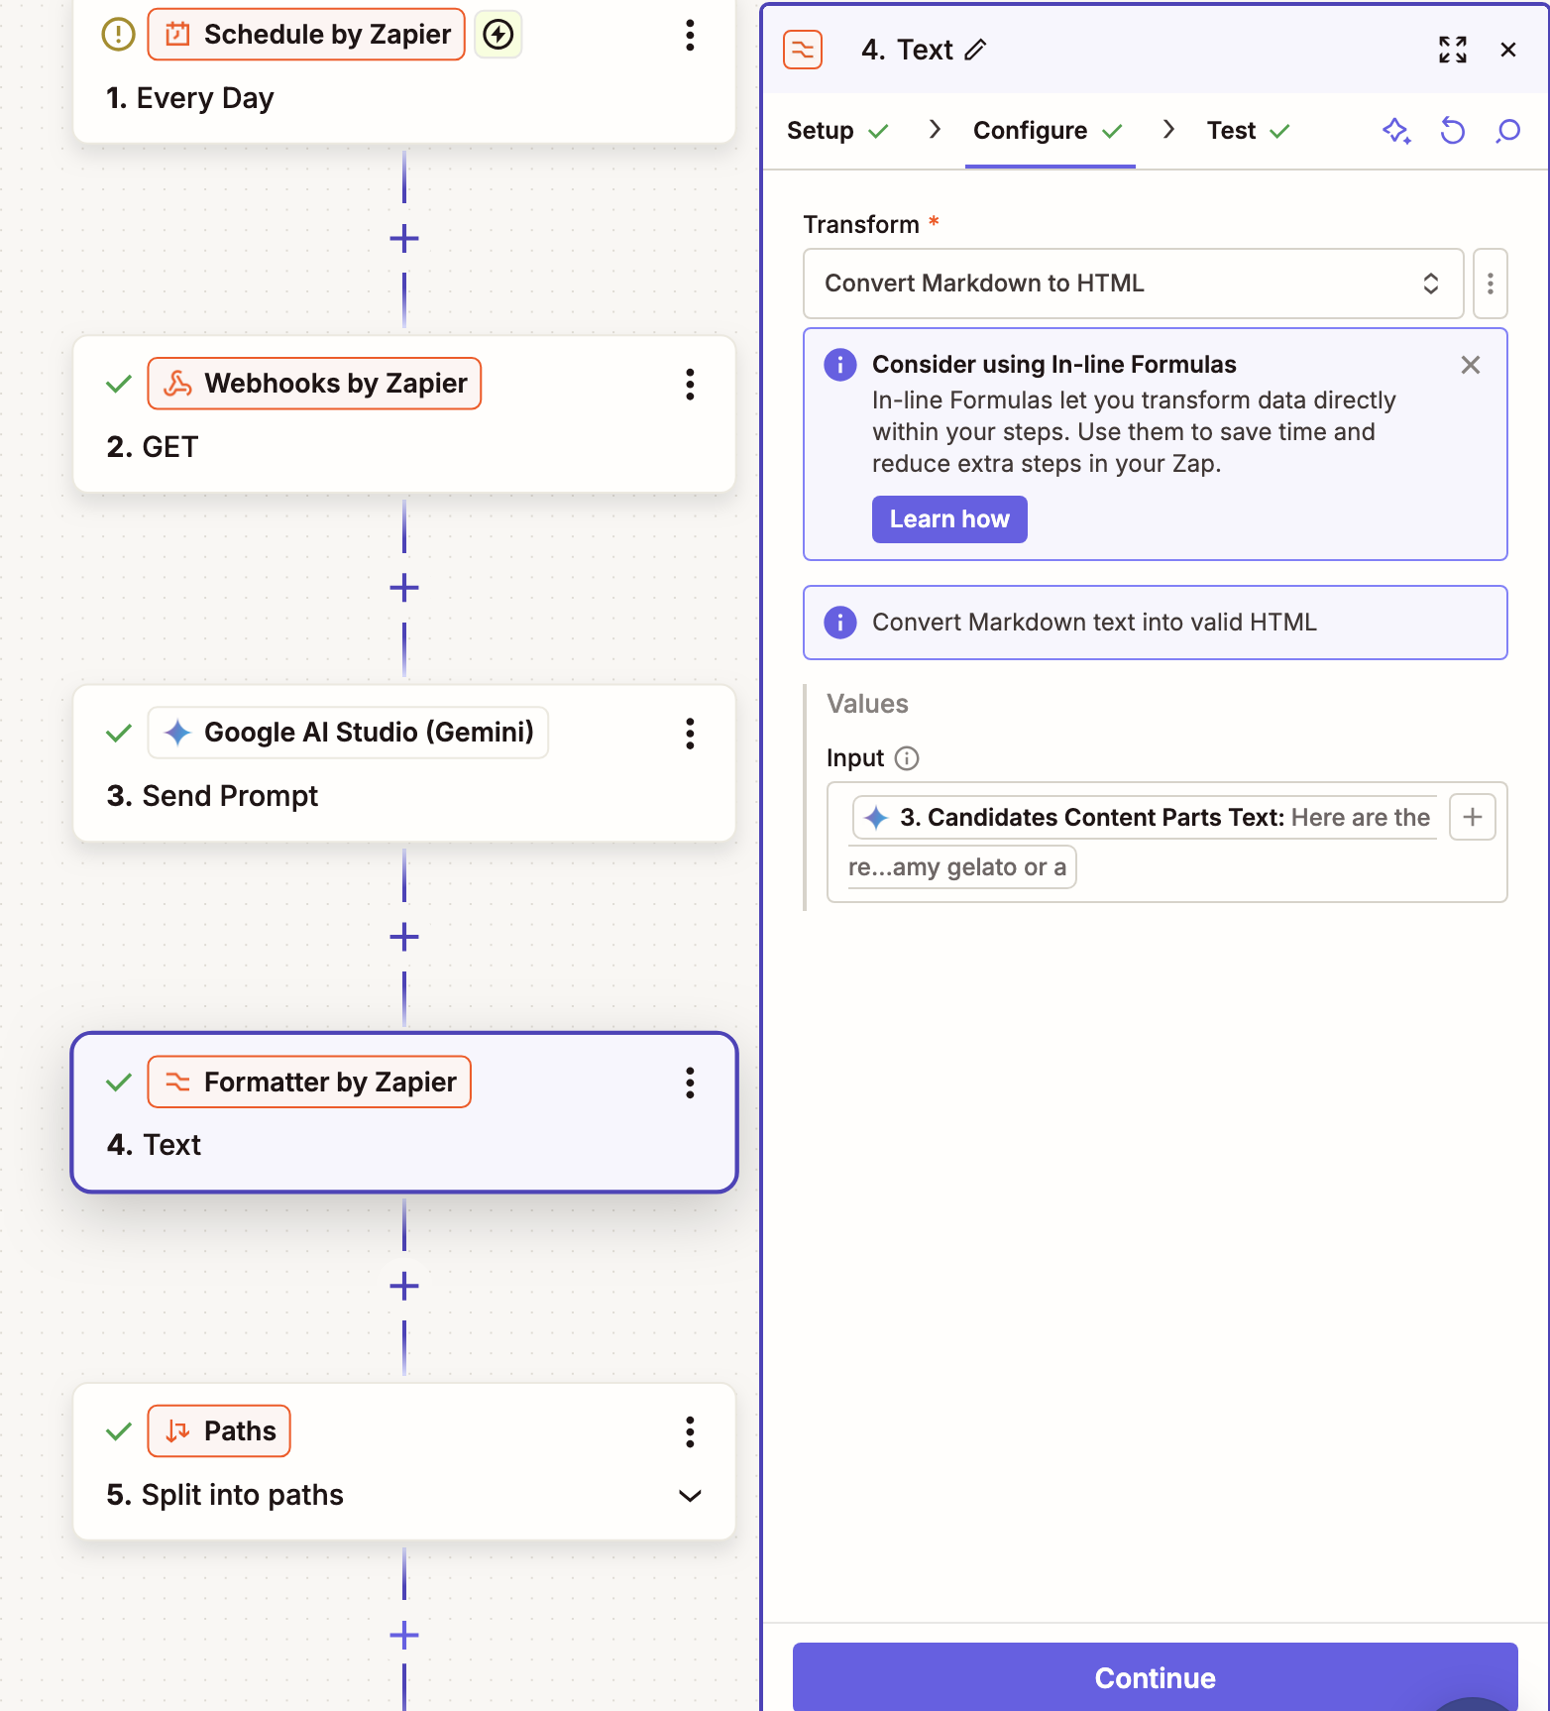
Screenshot of Formatter by Zapier module

Slide 13
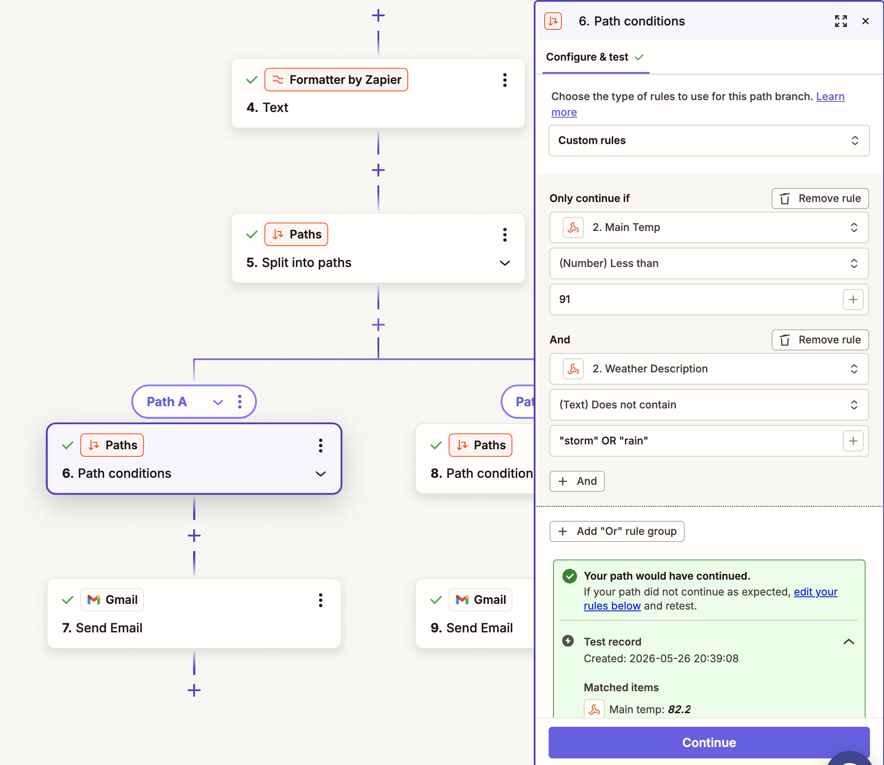
Screenshot of Path A that sends the email with AI block generated content

Slide 14
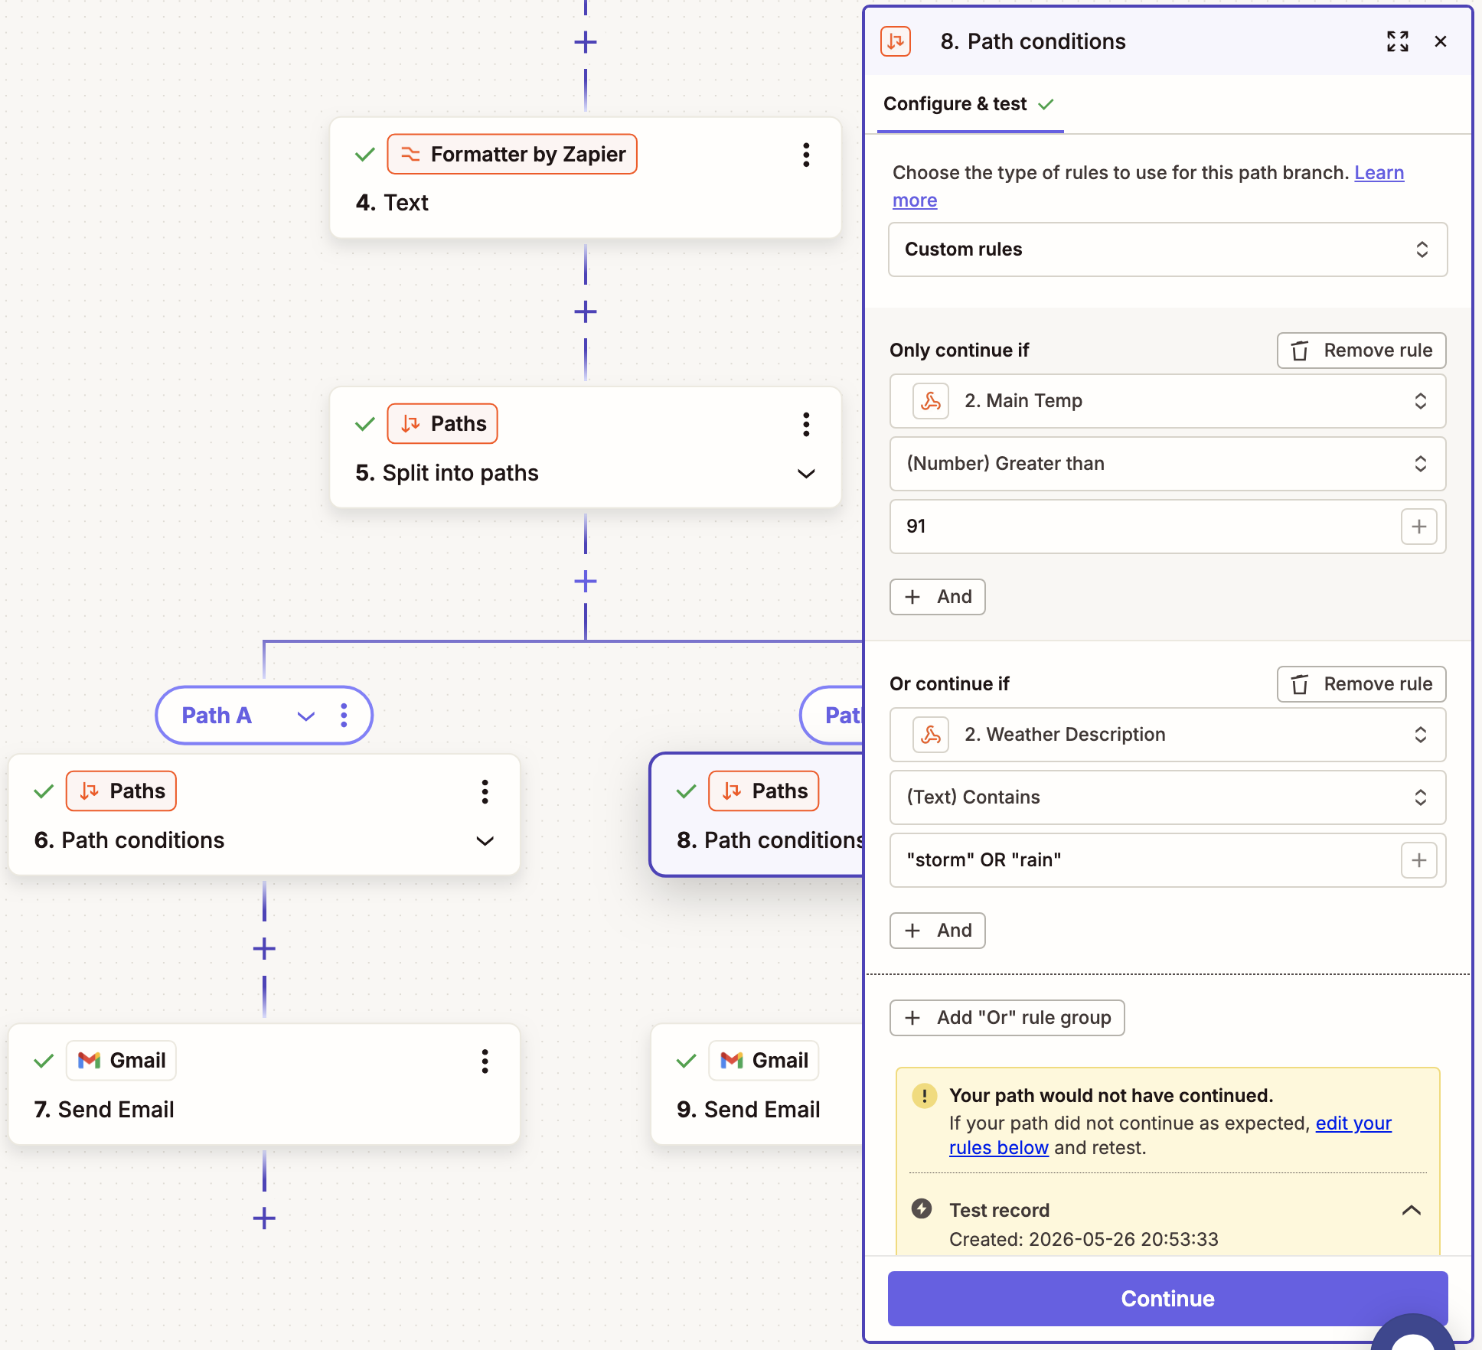
(Optional) Screenshot of Path B that sends the weather warning email

Slide 15
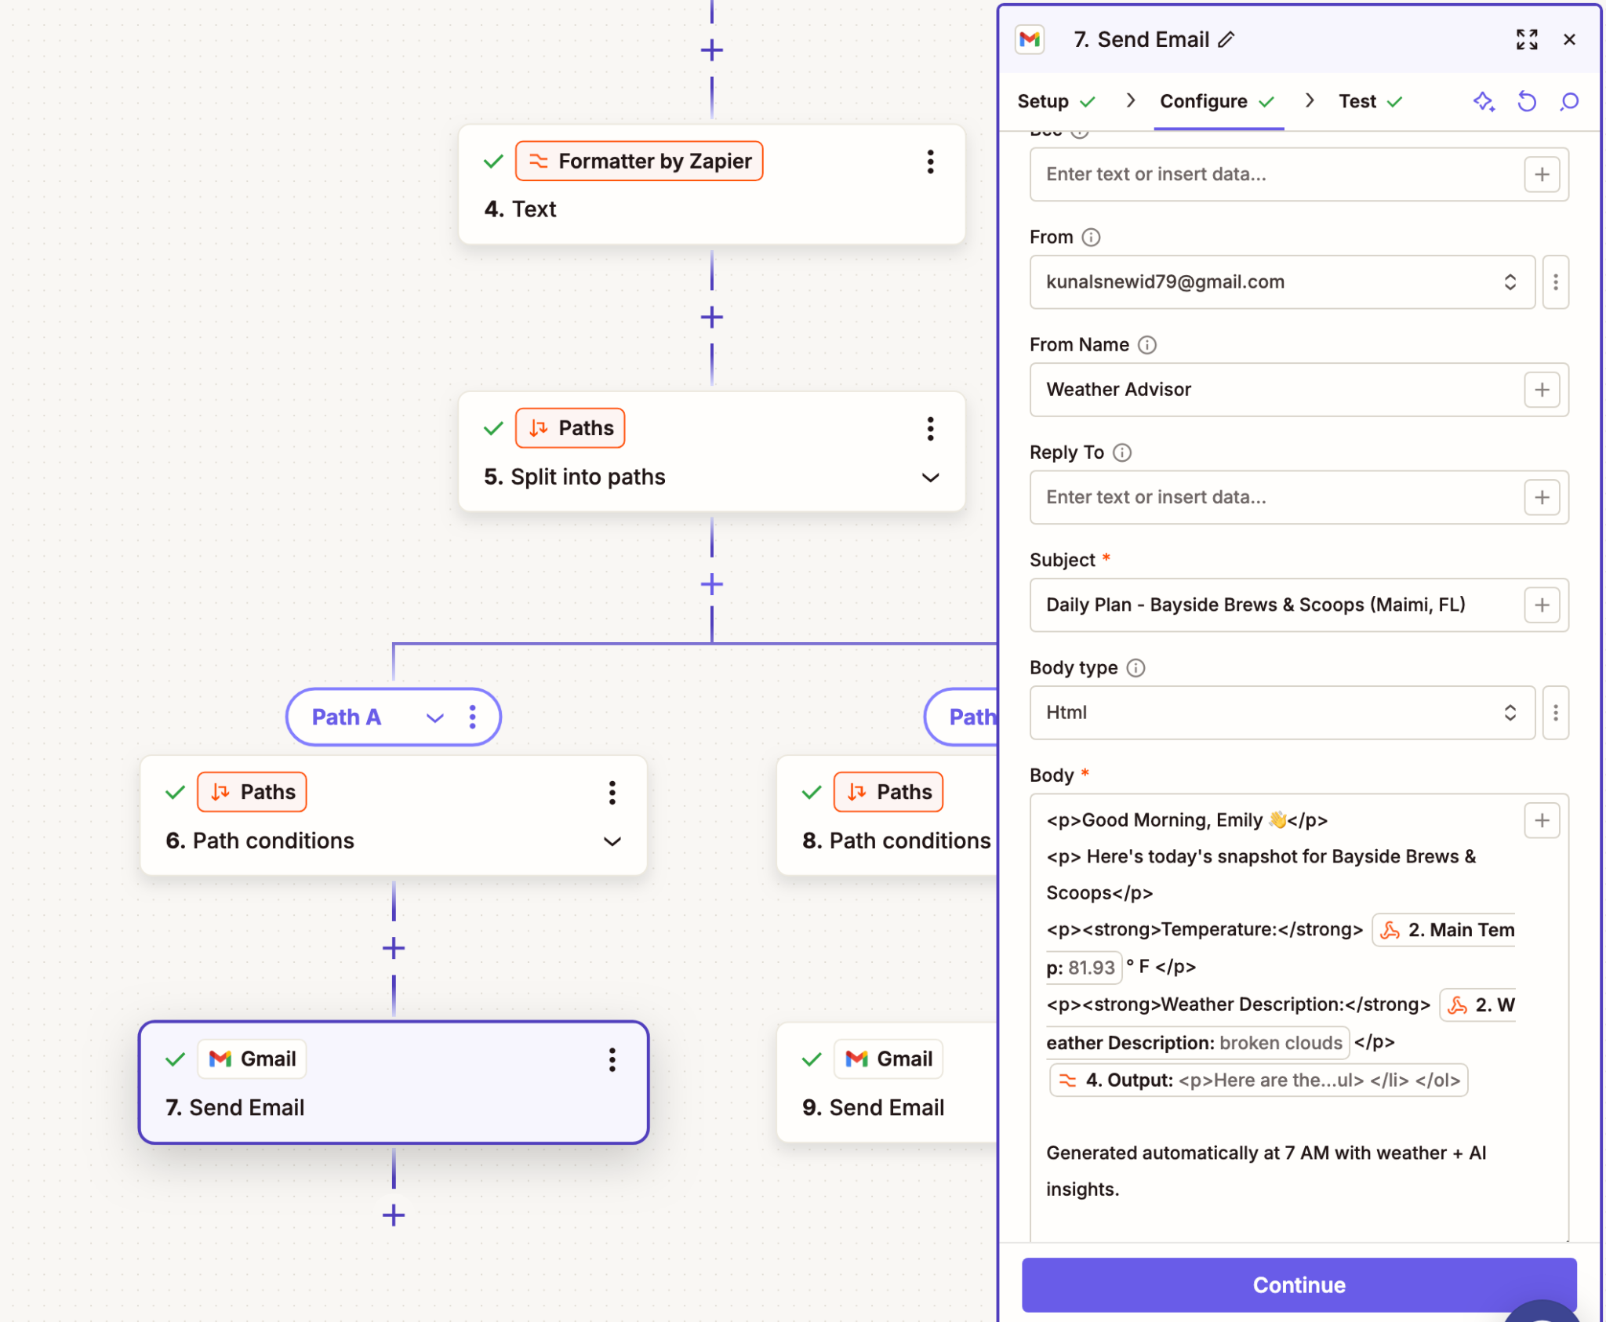
Screenshot of Gmail block with data from Gemini AI for the kiosk manager

Slide 16
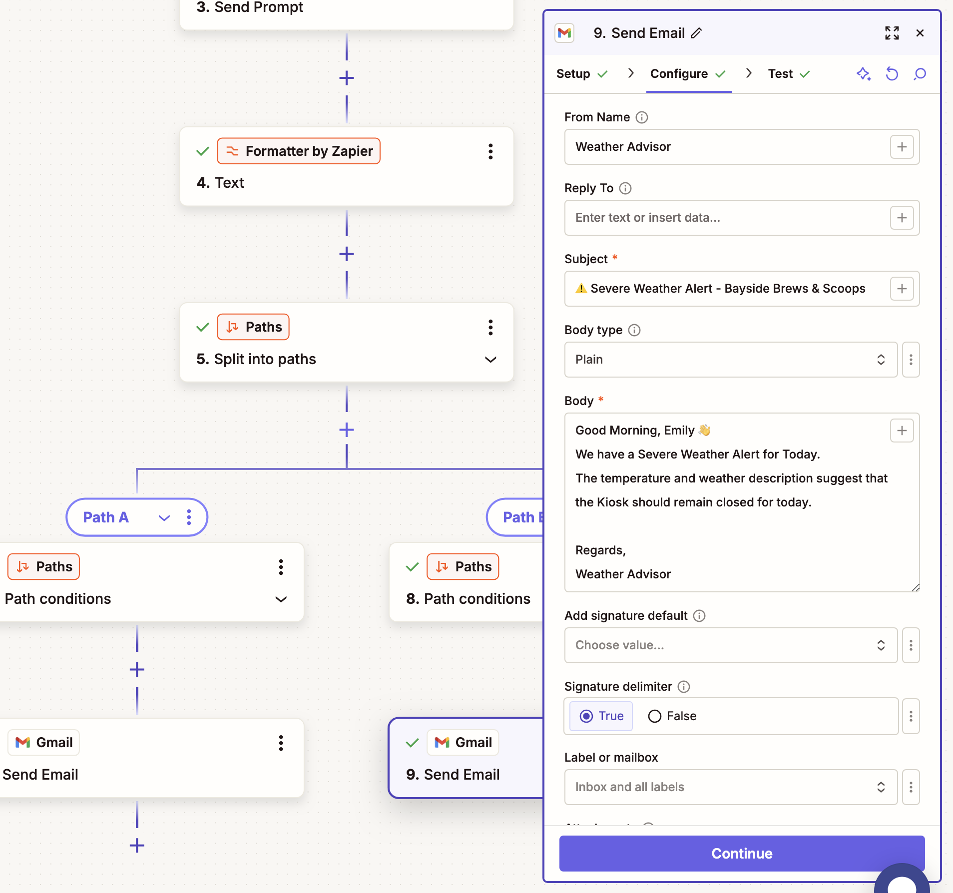
(Optional) Screenshot of GMail weather warning sent to the Kiosk manager

Slide 17
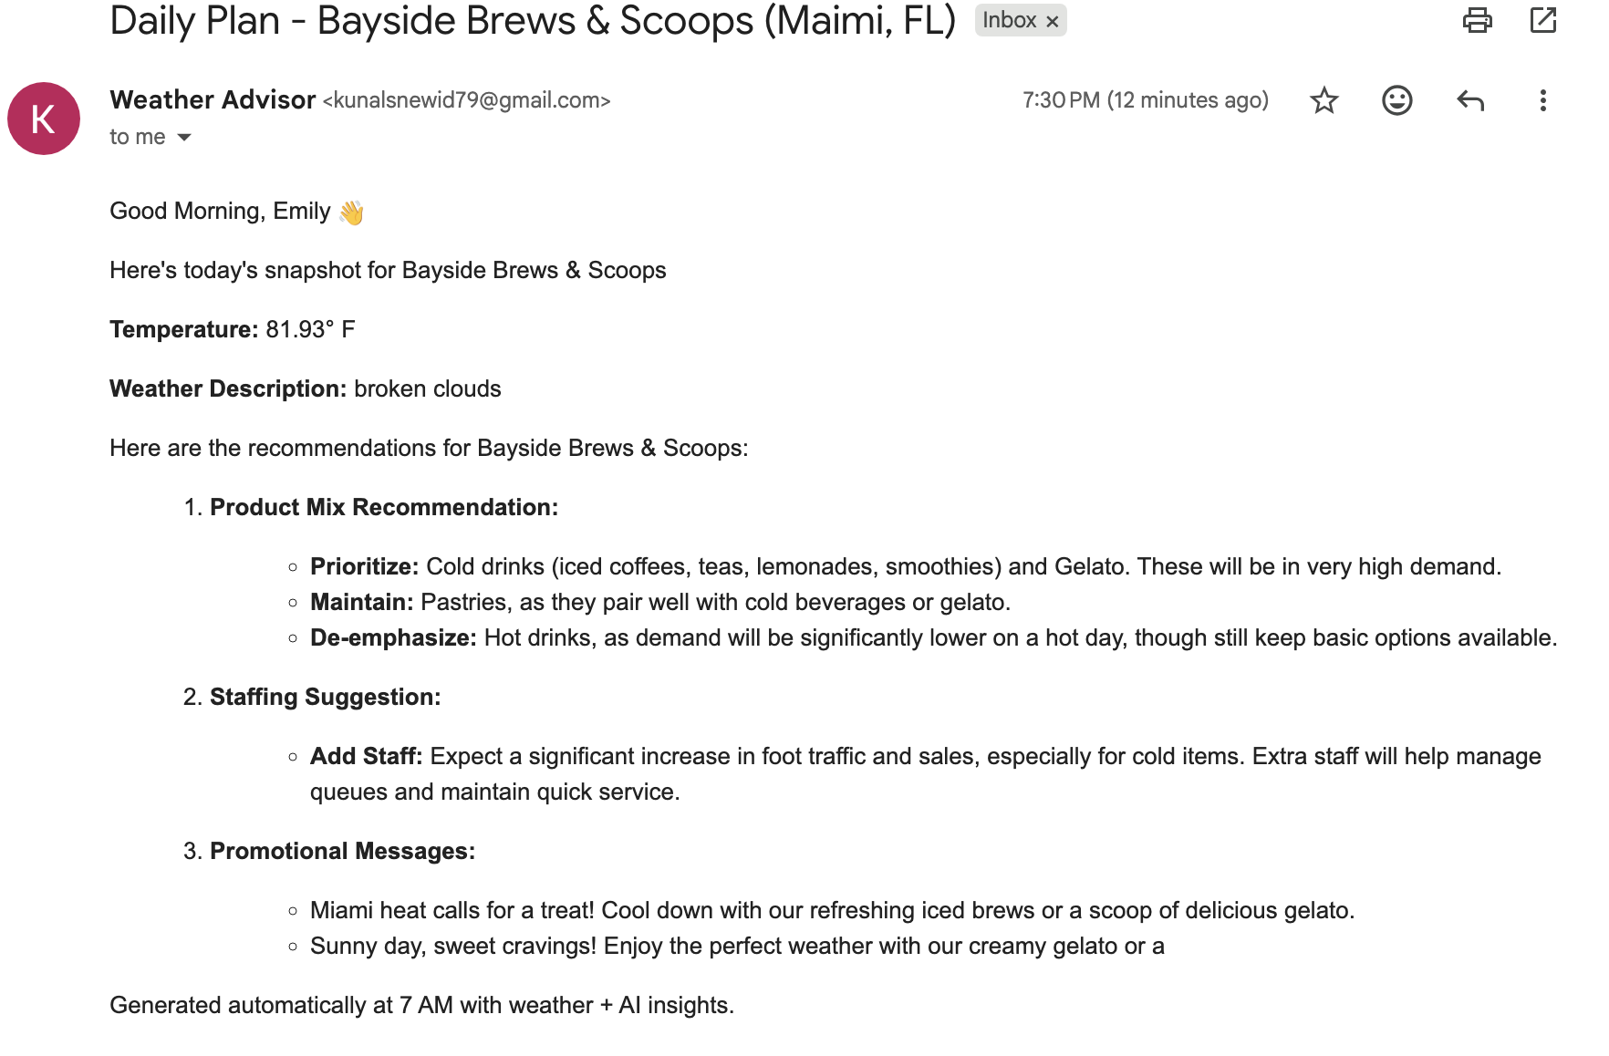
Screenshot of Actual Email with Google Gemini AI generated data received by the Kiosk manager

Slide 18
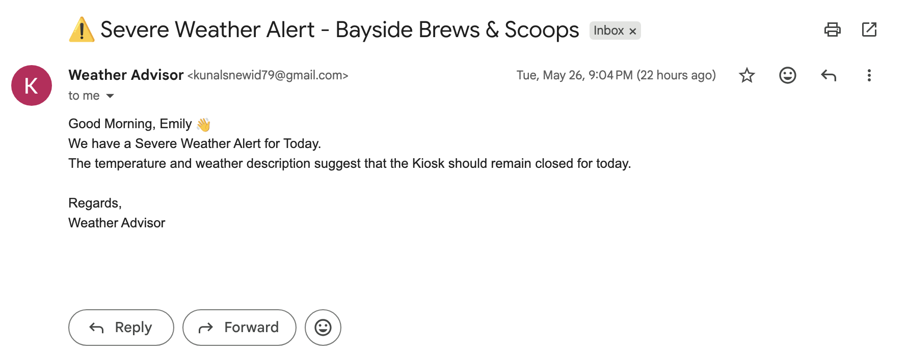
(Optional) Screenshot of Weather Warning email received by the Kiosk Manager

Slide 19
Challenges & improvements
Challenge: The Google Gemini AI block that was used to generate content for the kiosk manager was sometimes overloading and not giving the desired output when tested. The rest of the modules were functioning fine
Improvements: If there was more time, I would have added more logic for events like severe thunderstorms. I could have also learnt more about HTML formatting so that more descriptive and better looking emails could be sent out by the Gmail module.

